Slide 1
Ligation Strategies

Slide 2
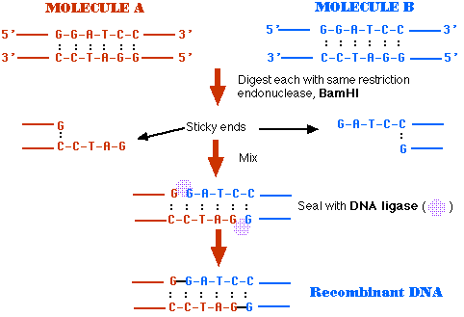
Ligating Compatible Sticky Ends- Easy
Eg. BamHI cut fragment with BamHI cut fragment

Slide 3
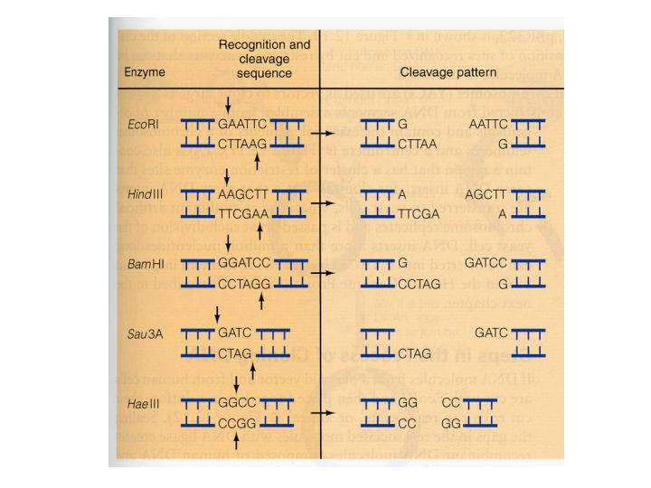
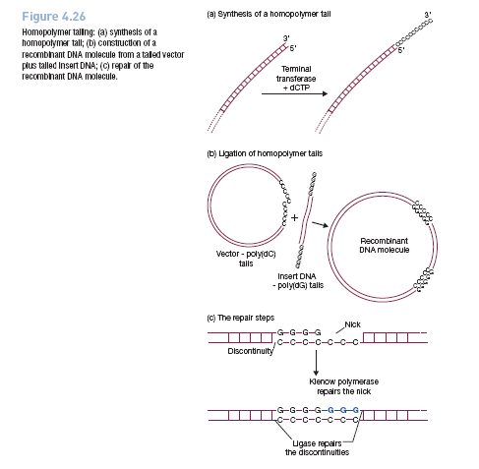
Ligating Blunt Ends
Option- Add compatible terminal nucleotides
Notes:
Directionality problem

Slide 4
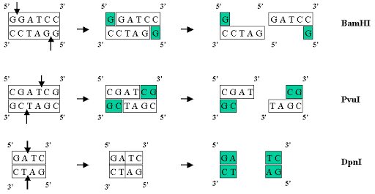
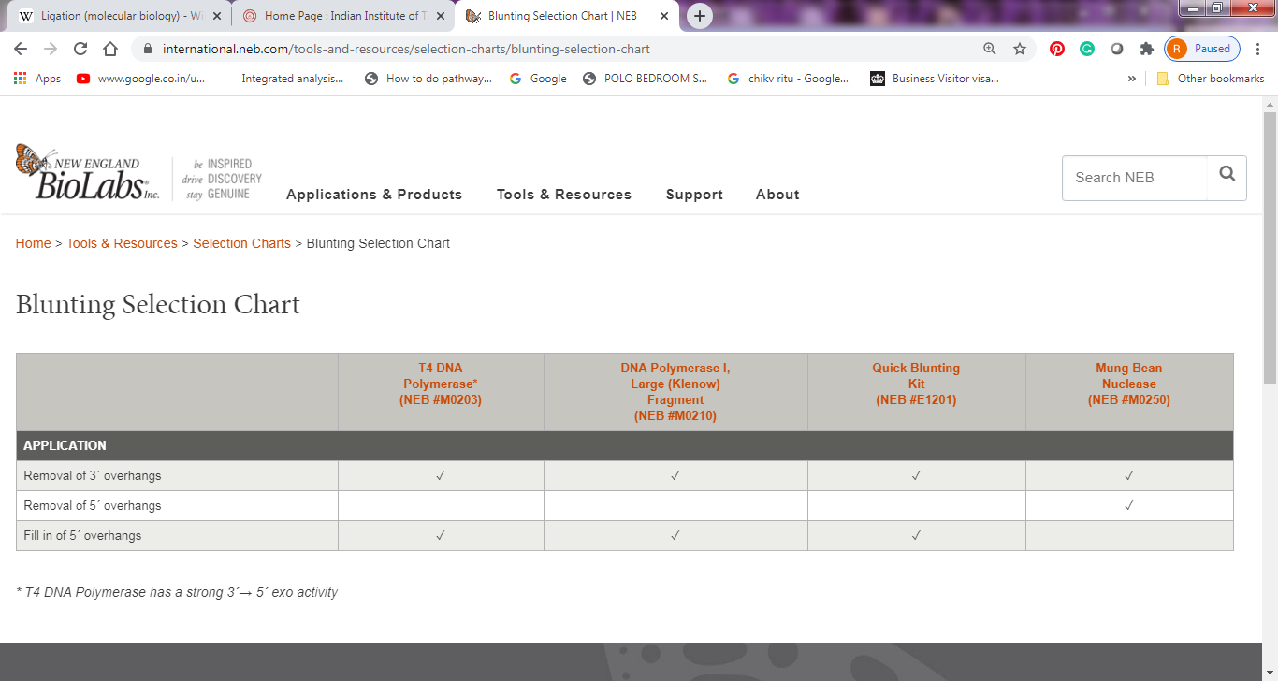
Ligating Blunt Ends with sticky ends (5’ or 3’ overhangs)
Option 1- Removal of 5’ or 3’ overhangs or fill-in of 5’ overhangs
Disadvantage- You will lose some bases and RE site (in case you remove, also no directionality

Slide 5
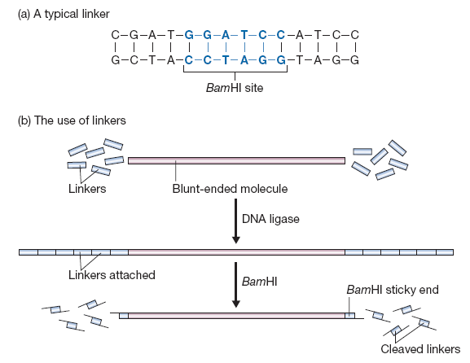
Ligating Blunt Ends to Sticky Ends- Use of Linkers
Option 2- Add linkers with RE sites to the blunt end molecule

Slide 6
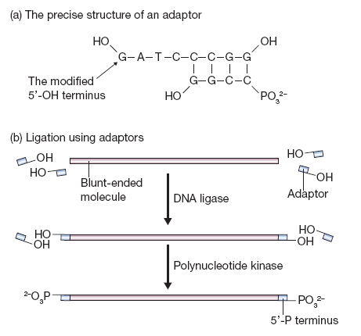
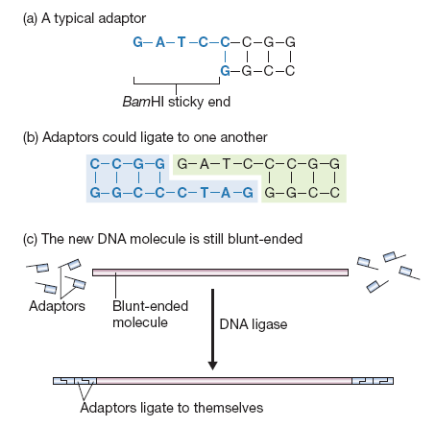
Ligating Blunt Ends to Sticky Ends- Use of Adaptors
Option 3- Add Adaptors with compatible overhangs to the blunt end molecule

Slide 7
Ligating Incompatible Sticky Ends
Eg. EcoRI cut fragment with HindIII cut fragment
Options:
1) Make both molecules blunt by using
Mungbean nuclease to remove overhangs- Disadvantage (lose the bases/RE sites)
Use T4 DNA polymerase- Will fill in the 5’overhangs and remove 3’ overhangs
Or
2) Add compatible adaptors to each molecule and then ligate

Slide 8
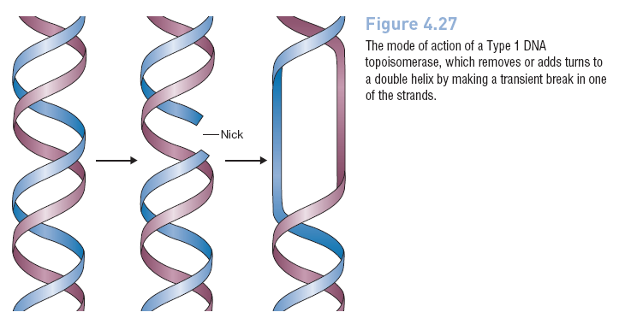
Ligation using DNA Topoisomerases

Slide 9
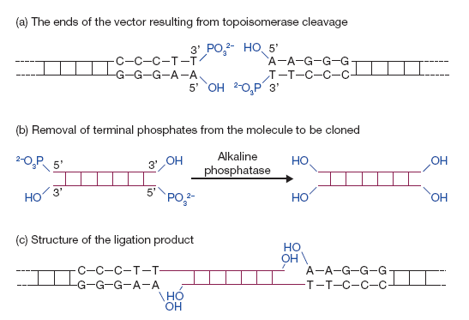
Ligation by DNA topoisomerase
Notes:
https://www.youtube.com/watch?v=7ZtpcKGZxfA
Blunt end ligation with a DNA topoisomerase. (a) Cleavage of the vector with the topoisomerase leaves blunt ends with 5′-OH and 3′-P termini. (b) The molecule to be cloned must therefore be treated with alkaline phosphatase to convert its 5′-P ends into 5′-OH termini. (c) The topoisomerase ligates the 3′-P and 5′-OH ends, creating a double-stranded molecule with two discontinuities, which are repaired by cellular enzymes after introduction into the host bacteria.
The TOPO technique specifically uses Vaccinia virus-isolated topoisomerase I as this enzyme recognizes the DNA sequence 5´-(C/T)CCTT-3' and digests double stranded DNA at this sequence. The energy from this breakage is stored as a covalent bond between the cleaved 3′ DNA strand and a tyrosyl residue of topoisomerase I (1). If a 5′ hydroxyl group from a different DNA strand comes along, it can attack this covalent bond thus joining the two DNA strands and releasing topoisomerase (2).

Slide 10
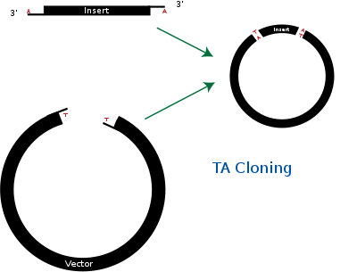
TA vectors
TA cloning (also known as rapid cloning or T cloning) is a subcloning technique that avoids the use of restriction enzymes[1] and is easier and quicker than traditional subcloning. The technique relies on the ability of adenine (A) and thymine (T) (complementary basepairs) on different DNA fragments to hybridize and, in the presence of ligase, become ligated together. PCR products are usually amplified using Taq DNA polymerase which preferentially adds an adenine to the 3' end of the product. Such PCR amplified inserts are cloned into linearized vectors that have complementary 3' thymine overhangs.[2]
Notes:
https://en.wikipedia.org/wiki/TA_cloning
https://www.thermofisher.com/in/en/home/life-science/cloning/cloning-learning-center/invitrogen-school-of-molecular-biology/molecular-cloning.html?ICID=EDUP2-anzaFundamentals-2016-02-02.html

Slide 11
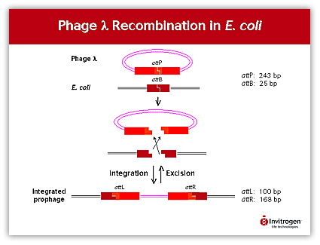
GATEWAY TECHNOLOGY
Notes:
BP clonase- Integrase, Integration Host Factor
LR clonase- Integrase, Integration Host Factor, Excisionase

Slide 12
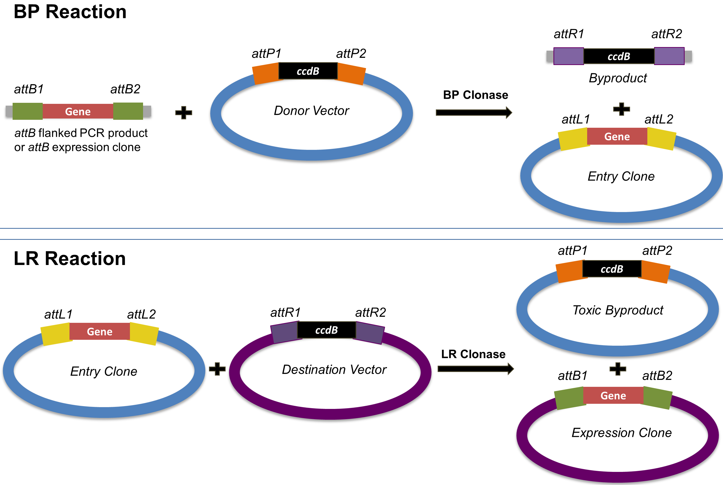

Slide 13
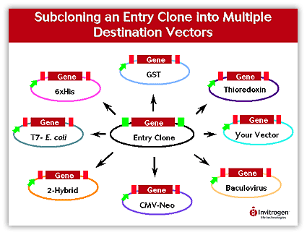

Slide 14
Gateway cloning
https://www.youtube.com/watch?v=qGSI5qxPDM0
https://www.embl.de/pepcore/pepcore_services/cloning/cloning_methods/recombination/gateway/
https://blog.addgene.org/plasmids-101-gateway-cloning
Notes:
https://www.embl.de/pepcore/pepcore_services/cloning/cloning_methods/recombination/gateway/

